Slide 1

Event Hub
Group 2

Slide 2
Phase 1

Slide 3
Objective
To build a unified event management system for organizers and attendees.
To allow organizers to create, update, and manage their events easily.
To enable users to discover, search, and book events conveniently.
To ensure smooth integration using a hybrid, API-driven MERN stack.
To include features like ticketing, payments, analytics, and engagement tools.

Slide 4
Problem Statement
Organizers find it hard to create, promote, and manage events easily.
No single platform to handle all event tasks in one place.
Users face problems finding and booking events quickly.
There are no real-time updates or easy ways to engage attendees.

Slide 5
Motivation
To make event creation and management easy in one platform.
To help users quickly find and book events.
To give organizers better reach and easy data handling.
To use modern MERN technology for a smooth and scalable system.

Slide 6
Target Users
Individual Organizers: Host small events like workshops or parties.
Event Agencies: Manage multiple events, ticketing, and promotions.
Corporates: Organize conferences, webinars, and exhibitions.
Communities & Non-Profits: Run fundraisers and awareness programs.
Attendees: Discover, book, and attend events easily.

Slide 7
System Environment
Web-based platform accessible through browsers.
Compatible with desktop and mobile devices.
Connected to a secure backend server and database.
Hosted on cloud platforms for better performance and uptime.

Slide 8
Functional Requirements
User registration and login (attendee, organizer, admin).
Event creation, update, and deletion by organizers.
Event search and filter by category, location, or date.
Ticket booking and online payment (Razorpay).
Notifications and reminders for events.
Reviews and ratings after event completion.

Slide 9
Non-Functional Requirements
Performance: Fast response time (< 2 seconds).
Availability: High uptime (around 99%).
Security: JWT authentication and encrypted passwords.
Scalability: Should handle multiple users and events easily.
Usability: Simple and responsive UI.
Deployment: Hosted on Vercel for web accessibility.

Slide 10
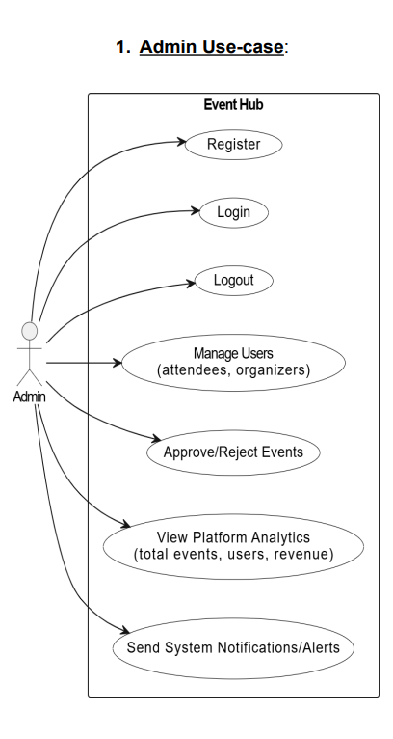
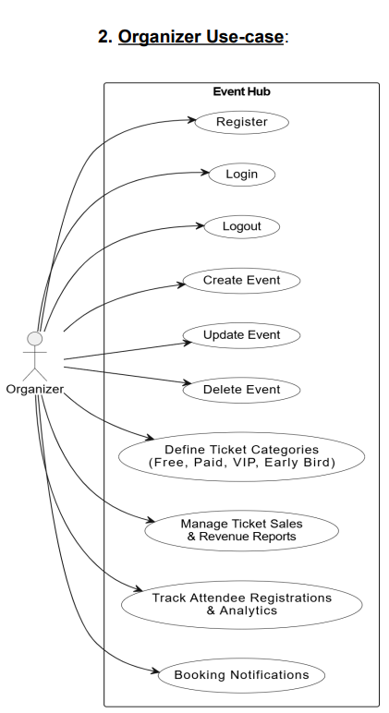
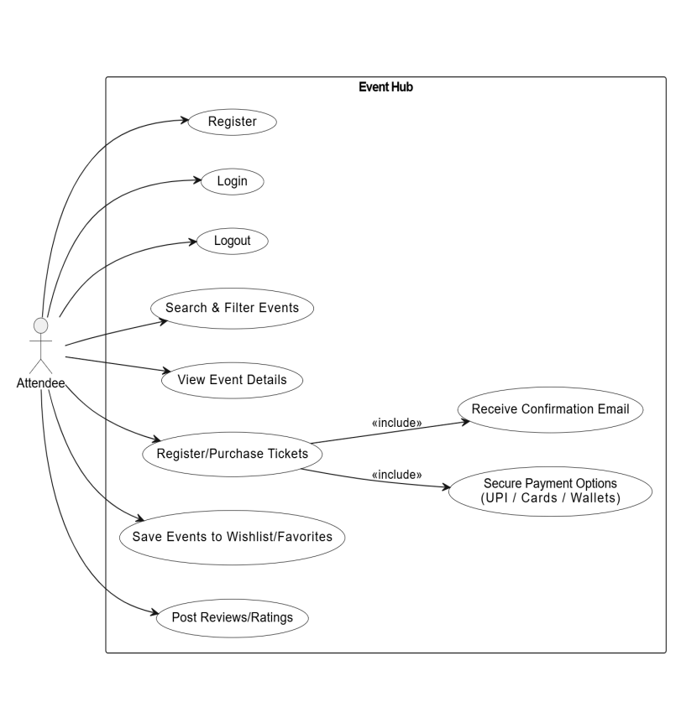

Use Case Diagram

Slide 11
User Stories
As a user, I want to search and book events easily so I can attend them.
As an organizer, I want to create and manage events so I can track ticket sales.
As an admin, I want to monitor all events and users to ensure smooth operations.

Slide 12
Technology Stack Justification
MongoDB: Used as the database for flexible and fast data storage of users, events, and bookings.
Express.js: Simplifies backend routing and API creation.
React.js: Provides a responsive and dynamic web interface for the admin panel.
Node.js: Handles server-side logic and ensures fast performance.

Slide 13
Phase 2

Slide 14
Added New Feature
Description:
A digital event passport that stores all events attended by a user.
It tracks their participation and gives real rewards like free entries or heavy discounts based on how many events they attend.
User Story:
As a user, I want a digital event passport so I can see my event history and unlock real perks such as free events or big discounts.
For example: After attending 5 events, the user gets 40% off on any ticket.

Slide 15
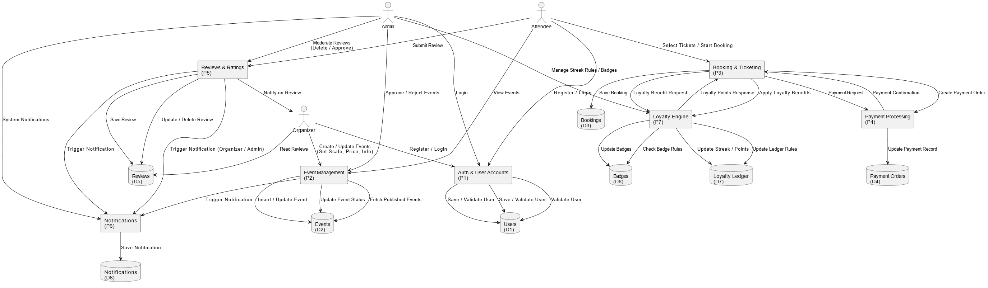
Data Flow Diagram (Level 1)

Slide 16
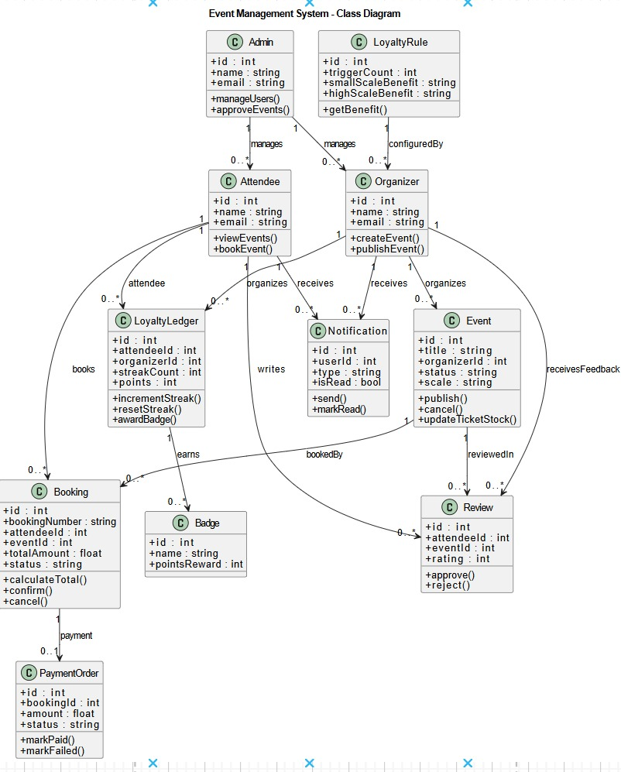
Class Diagram

Slide 17
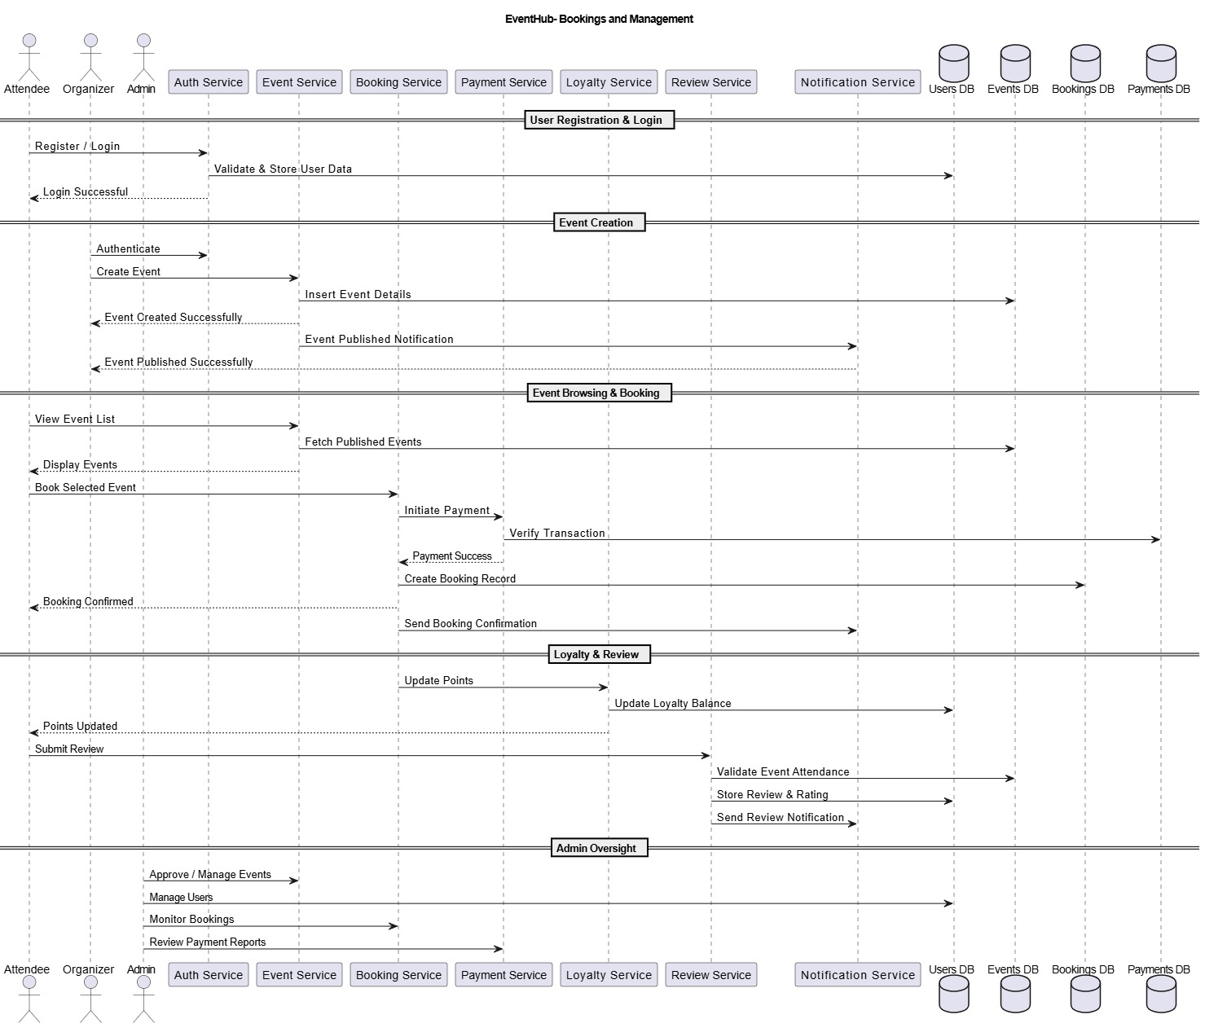
Sequence Diagram

Slide 18
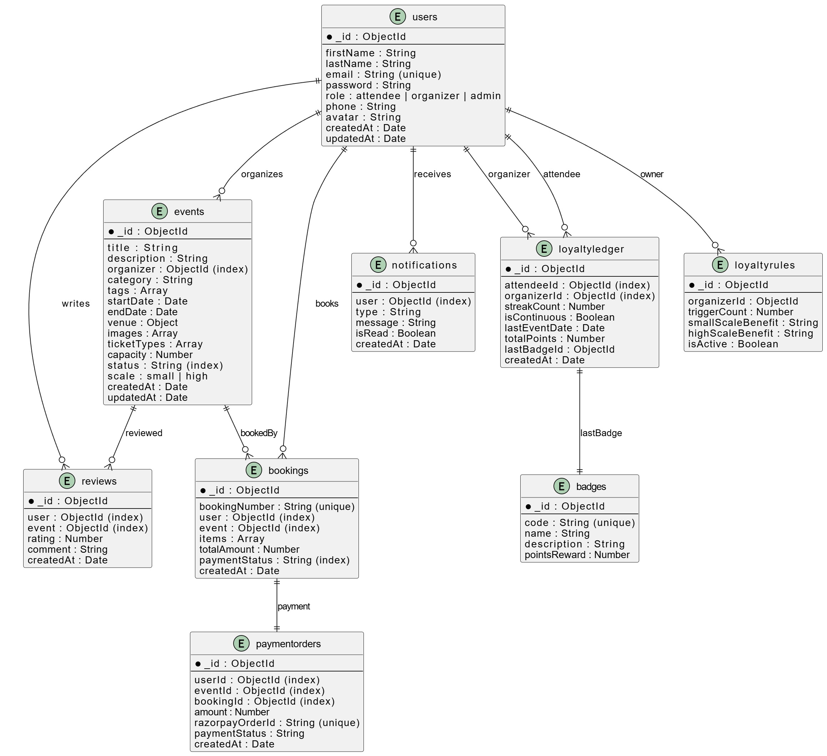
Schema Diagram

Slide 19
Factory Pattern
Definition:
Creates objects without exposing creation logic; lets subclasses decide which class to instantiate.
Why Used:
Dynamic creation of payment providers.
Multiple notification channels (Email/SMS/In-App).
Easy future extension.
Where Used:
PaymentService → chooses correct payment handler.
NotificationService → selects message sender.

Slide 20
Strategy Pattern
Definition:
Defines interchangeable algorithms; selects behavior at runtime.
Why Used:
Event benefits vary by scale (Free ticket vs Discount).
Where Used:
LoyaltyService → benefit calculation strategies.

Slide 21

Observer Pattern
Definition:
Event triggers automatic updates to multiple listeners.
Why Used:
Booking confirmation → notify attendee
Review submitted → notify organizer
Event published → notify users
Where Used:
NotificationService listens to creation, review, and payment events.

Slide 22
Singleton Pattern
Definition:
Ensures a single instance of a class throughout the application.
Why Used:
One MongoDB connection
One Razorpay client
One LoyaltyService instance
Where Used:
DB connection module
Payment gateway client
Loyalty rule handler

Slide 23

State Pattern
Definition:
Object behavior changes based on its internal state.
Why Used:
Booking: pending → confirmed → cancelled
Payment: pending → paid → failed → refunded
Event: draft → published → completed
Where Used:
Booking.status
PaymentOrder.status
Event.status

Slide 24
Phase 3

Slide 25
Code walkthrough of key modules.
API design: RESTful routes under /api/* (see routes/ files)
Separation of concerns: Routes → Controllers → Models → Utils
Validation & Security: express-validator, helmet, express-rate-limit, cors
Config & secrets: dotenv + config/*; env vars kept in .env (not checked into VCS)
Style guidance (recommended): consistent JS formatting, descriptive commit messages, linting (add ESLint), unit tests (add Jest)
Presenter notes: Emphasize clarity in controllers and modular routes; note missing lint/tests and recommend adding CI.

Slide 26
Repository Structure & Key Files Pages
Pages (/src/pages)
BookingConfirmation
Categories
CreateEvent
Dashboard
EventDetails
Events
Login
ManageEvents
ManageUsers
PaymentPage
Profile
PublicProfile
Register
Settings

Slide 27
Main Components [Frontend]
UI Components (/src/components)
CallToAction
CategorySection
EditProfileForm
FeaturedEvents
Footer
Header
HeroSection
HostedEvents
Logout
Reviews
StatsSection

Slide 28
Main Components [Backend]
Core Backend Structure
server.js – main server entry point
config/ – configuration files
controllers/ – request handlers
middleware/ – authentication, validation, etc.
models/ – MongoDB models
routes/ – API route definitions
utils/ – helper functions
generatesign.js – signature generation

Slide 29
Key Module Walkthrough
server.js : app bootstrap, middleware, route mounting, health-check endpoint (/api/health)
database.js : connects to MongoDB via process.env.MONGODB_URI
controllers/authController.js: authentication, JWT creation/verification (explain at high level)
models/User.js & models/Event.js: schemas and relationships (bookings/ref)
routes/events.js + controllers/eventController.js: event CRUD and search
Frontend services/api.js: centralizes axios calls and base API URL

Slide 30
Functional Prototype — How to Run Demo
Prerequisites: Node.js, npm, MongoDB (or Mongo Atlas), Redis (optional)
Backend (power shell commands):
  cd "c:\My Projects\EventHub-back\EventHub\backend"
  npm install
  create .env with keys:
    MONGODB_URI, PORT (optional), FRONTEND_URL, JWT_SECRET, RAZORPAY_KEY_ID, RAZORPAY_KEY_SECRET, SMTP settings if email used
  npm run dev (uses nodemon) or npm start
Frontend (power shell commands):
  cd "c:\My Projects\EventHub-back\EventHub\frontend"
  npm install
  npm start
Quick demo checklist: Open http://localhost:3000 (frontend); backend health-check: GET http://localhost:5000/api/health
Presenter notes: Show the health-check JSON response; demonstrate create user → login → book → payment flow (if Razorpay keys present simulate test keys).

Slide 31
Version Control & Collaborative Workflow
Suggested branching model: main (protected) + feature branches feature/<name>, bugfix/<id>, hotfix/<id>
PR process: small PRs, reviewer checklist (lint, tests, API contract), link to issue ticket
CI suggestions: Setup GitHub Actions or GitLab CI to run npm test (add tests), ESLint, and build for frontend
Release & tagging: Semantic versioning tags vMAJOR.MINOR.PATCH on main after merge
Presenter notes: Recommend enabling branch protection and PR templates; show example PR checklist.

Slide 32

GitHub Repository
https://github.com/rajvi2809/EventHub

Slide 33
Thank You

